Slide 1
Cryptography and Network Security
DATA ENCRYPTION STANDARD

Slide 2
Session Meta Data
Author | Dr T Sree Sharmila
Reviewer
Version Number | 1.0
Release Date | 1 July 2018

Slide 3
Revision History
Revision Date | Details | Version no.
 |  | 1.0

Slide 4
Agenda
Introduction
Block Vs stream cipher
Block cipher principles
Feistel cipher structure
Feistel cipher design principles
DES
Encryption
Initial permutation
Round structure
Substitution boxes
Key schedule
Decryption
Avalanche effect
Strength of DES

Slide 5
Introduction
one of the most widely used types of cryptographic algorithms
provide secrecy and/or authentication services
in particular will introduce DES (Data Encryption Standard)
Notes:
Modern block ciphers are widely used to provide encryption of quantities of information, and/or a cryptographic checksum to ensure the contents have not been altered. We continue to use block ciphers because they are comparatively fast, and because we know a fair amount about how to design them.

Slide 6
Agenda
Introduction
Block Vs stream cipher
Block cipher principles
Feistel cipher structure
Feistel cipher design principles
DES
Encryption
Initial permutation
Round structure
Substitution boxes
Key schedule
Decryption
Avalanche effect
Strength of DES

Slide 7
Block vs Stream Ciphers
block ciphers process messages into blocks, each of which is then en/decrypted
like a substitution on very big characters
64-bits or more
stream ciphers process messages a bit or byte at a time when en/decrypting
many current ciphers are block ciphers
hence are focus of course
Notes:
Block ciphers work a on block / word at a time, which is some number of bits. All of these bits have to be available before the block can be processed. Stream ciphers work on a bit or byte of the message at a time, hence process it as a “stream”.

Slide 8
Agenda
Introduction
Block Vs stream cipher
Block cipher principles
Feistel cipher structure
Feistel cipher design principles
DES
Encryption
Initial permutation
Round structure
Substitution boxes
Key schedule
Decryption
Avalanche effect
Strength of DES

Slide 9
Block Cipher Principles
most symmetric block ciphers are based on a Feistel Cipher Structure
needed since must be able to decrypt ciphertext to recover messages efficiently
block ciphers look like an extremely large substitution
would need table of 2⁶⁴ entries for a 64-bit block
instead create from smaller building blocks
using idea of a product cipher
Notes:
An arbitrary reversible substitution cipher for a large block size is not practical, however, from an implementation and performance point of view. In general, for an n-bit general substitution block cipher, the size of the key is n x 2^{n}. For a 64-bit block, which is a desirable length to thwart statistical attacks, the key size is 64 x 2⁶⁴ = 2⁷⁰ = 10²¹ bits.

Slide 10
Claude Shannon and Substitution-Permutation Ciphers
in 1949 Claude Shannon introduced idea of substitution-permutation (S-P) networks
modern substitution-transposition product cipher
these form the basis of modern block ciphers
S-P networks are based on the two primitive cryptographic operations we have seen before:
substitution (S-box)
permutation (P-box)
provide confusion and diffusion of message
Notes:
Claude Shannon’s 1949 paper has the key ideas that led to the development of modern block ciphers. Critically, it was the technique of layering groups of S-boxes separated by a larger P-box to form the S-P network, a complex form of a product cipher. He also introduced the ideas of confusion and diffusion, notionally provided by S-boxes and P-boxes (in conjunction with S-boxes).

Slide 11
Confusion and Diffusion
cipher needs to completely obscure statistical properties of original message
a one-time pad does this
more practically Shannon suggested combining elements to obtain:
diffusion – dissipates statistical structure of plaintext over bulk of ciphertext
confusion – makes relationship between ciphertext and key as complex as possible
Notes:
Every block cipher involves a transformation of a block of plaintext into a block of ciphertext, where the transformation depends on the key. The mechanism of diffusion seeks to make the statistical relationship between the plaintext and ciphertext as complex as possible in order to thwart attempts to deduce the key. confusion seeks to make the relationship between the statistics of the ciphertext and the value of the encryption key as complex as possible, again to thwart attempts to discover the key.
So successful are diffusion and confusion in capturing the essence of the desired attributes of a block cipher that they have become the cornerstone of modern block cipher design.

Slide 12
Agenda
Introduction
Block Vs stream cipher
Block cipher principles
Feistel cipher structure
Feistel cipher design principles
DES
Encryption
Initial permutation
Round structure
Substitution boxes
Key schedule
Decryption
Avalanche effect
Strength of DES

Slide 13
Feistel Cipher Structure
Horst Feistel devised the feistel cipher
based on concept of invertible product cipher
partitions input block into two halves
process through multiple rounds which
perform a substitution on left data half
based on round function of right half & subkey
then have permutation swapping halves
implements Shannon’s substitution-permutation network concept
Notes:
Horst Feistel, working at IBM Thomas J Watson Research Labs devised a suitable invertible cipher structure in early 70's.
One of Feistel's main contributions was the invention of a suitable structure which adapted Shannon's S-P network in an easily inverted structure. Essentially the same h/w or s/w is used for both encryption and decryption, with just a slight change in how the keys are used. One layer of S-boxes and the following P-box are used to form the round function.

Slide 14
Feistel Cipher Structure

Slide 15
Agenda
Introduction
Block Vs stream cipher
Block cipher principles
Feistel cipher structure
Feistel cipher design principles
DES
Encryption
Initial permutation
Round structure
Substitution boxes
Key schedule
Decryption
Avalanche effect
Strength of DES

Slide 16
Feistel Cipher Design Principles
block size
increasing size improves security, but slows cipher
key size
increasing size improves security, makes exhaustive key searching harder, but may slow cipher
number of rounds
increasing number improves security, but slows cipher
subkey generation
greater complexity can make analysis harder, but slows cipher
round function
greater complexity can make analysis harder, but slows cipher
fast software en/decryption & ease of analysis
are more recent concerns for practical use and testing

Slide 17
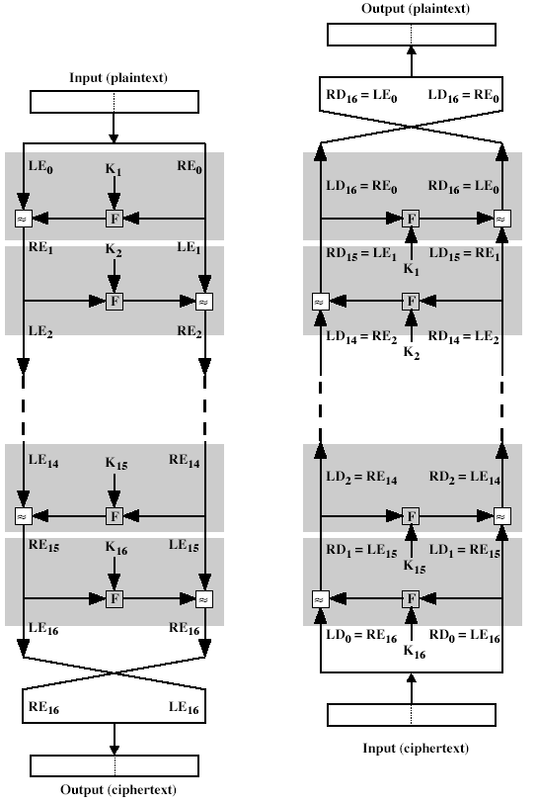
Feistel Cipher Decryption
Notes:
The process of decryption with a Feistel cipher is essentially the same as the encryption process. The rule is as follows: Use the ciphertext as input to the algorithm, but use the subkeys Ki in reverse order. That is, use Kn in the first round, Kn–1 in the second round, and so on until K1 is used in the last round. This is a nice feature because it means we need not implement two different algorithms, one for encryption and one for decryption.

Slide 18
Agenda
Introduction
Block Vs stream cipher
Block cipher principles
Feistel cipher structure
Feistel cipher design principles
DES
Encryption
Initial permutation
Round structure
Substitution boxes
Key schedule
Decryption
Avalanche effect
Strength of DES

Slide 19
Data Encryption Standard (DES)
most widely used block cipher in world
encrypts 64-bit data using 56-bit key
has widespread use
has been considerable controversy over its security

Slide 20
DES Design Controversy
although DES standard is public
was considerable controversy over design
in choice of 56-bit key (vs Lucifer 128-bit)
and because design criteria were classified
subsequent events and public analysis show in fact design was appropriate
DES has become widely used in financial applications
Notes:
Recent analysis has shown despite this controversy, that DES is well designed. DES is theoretically broken using Differential or Linear Cryptanalysis
but in practise is unlikely to be a problem yet. Also rapid advances in computing speed though have rendered the 56 bit key susceptible to exhaustive key search, as predicted by Diffie & Hellman. Have demonstrated breaks:
- 1997 on a large network of computers in a few months
- 1998 on dedicated h/w (EFF) in a few days
- 1999 above combined in 22hrs!

Slide 21
Agenda
Introduction
Block Vs stream cipher
Block cipher principles
Feistel cipher structure
Feistel cipher design principles
DES
Encryption
Initial permutation
Round structure
Substitution boxes
Key schedule
Decryption
Avalanche effect
Strength of DES

Slide 22
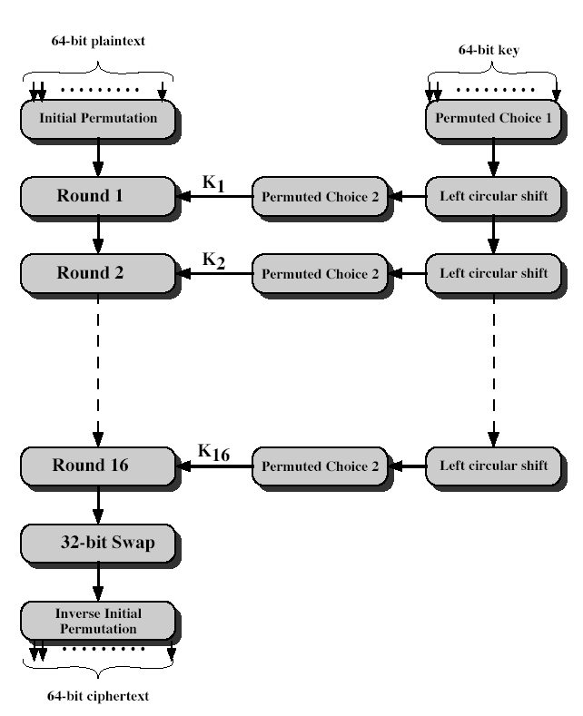
DES Encryption
Notes:
The basic process in enciphering a 64-bit data block using the DES, shown on the left side, consists of:
- an initial permutation (IP)
- 16 rounds of a complex key dependent round function involving substitution and permutation functions
- a final permutation, being the inverse of IP
The right side shows the handling of the 56-bit key and consists of:
- an initial permutation of the key (PC1) which selects 56-bits in two 28-bit halves
- 16 stages to generate the subkeys using a left circular shift and a permutation

Slide 23
Agenda
Introduction
Block Vs stream cipher
Block cipher principles
Feistel cipher structure
Feistel cipher design principles
DES
Encryption
Initial permutation
Round structure
Substitution boxes
Key schedule
Decryption
Avalanche effect
Strength of DES

Slide 24
Initial Permutation IP
first step of the data computation
IP reorders the input data bits
even bits to LH half, odd bits to RH half
quite regular in structure (easy in h/w)
Notes:
The initial permutation and its inverse are defined by tables, as shown in Tables 3.2a and 3.2b, respectively. The tables are to be interpreted as follows. The input to a table consists of 64 bits numbered from 1 to 64. The 64 entries in the permutation table contain a permutation of the numbers from 1 to 64. Each entry in the permutation table indicates the position of a numbered input bit in the output, which also consists of 64 bits.
Note that the bit numbering for DES reflects IBM mainframe practice, and is the opposite of what we now mostly use - so be careful! Numbers from Bit 1 (leftmost, most significant) to bit 32/48/64 etc (rightmost, least significant).
Note that examples are specified using hexadecimal.

Slide 25
Agenda
Introduction
Block Vs stream cipher
Block cipher principles
Feistel cipher structure
Feistel cipher design principles
DES
Encryption
Initial permutation
Round structure
Substitution boxes
Key schedule
Decryption
Avalanche effect
Strength of DES

Slide 26
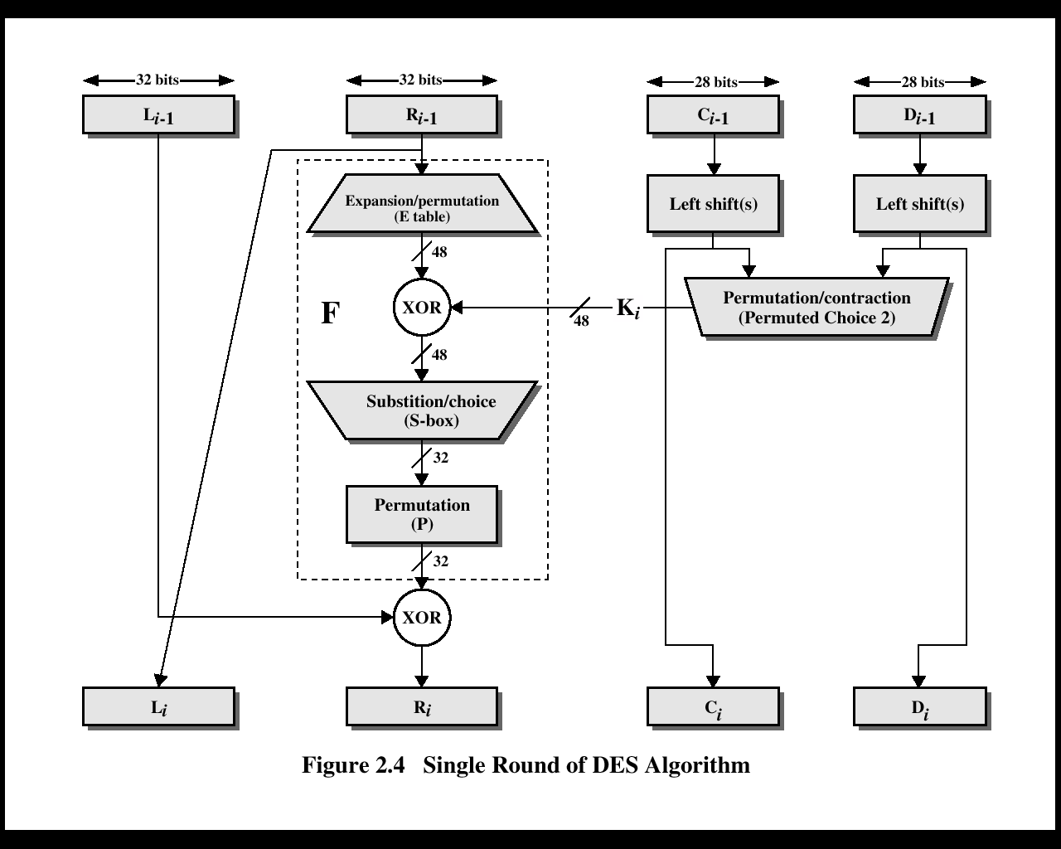
DES Round Structure

Slide 27
DES Round Structure
uses two 32-bit L & R halves
as for any Feistel cipher can describe as:
L_{i} = R_{i–1}
R_{i} = L_{i–1} xor F(R_{i–1}, K_{i})
takes 32-bit R half and 48-bit subkey and:
expands R to 48-bits using perm E
adds to subkey
passes through 8 S-boxes to get 32-bit result
finally permutes this using 32-bit perm P
Notes:
Note that the s-boxes provide the “confusion” of data and key values, whilst the permutation P then spreads this as widely as possible, so each S-box output affects as many S-box inputs in the next round as possible, giving “diffusion”.

Slide 28
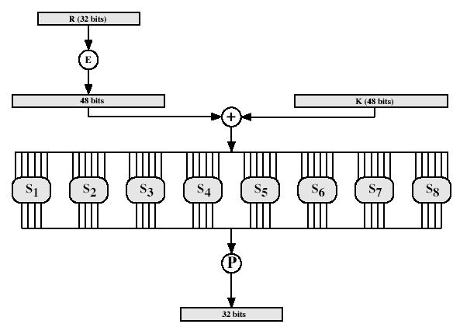
DES Round Structure
Notes:
Stallings Fig 3.9

Slide 29
Agenda
Introduction
Block Vs stream cipher
Block cipher principles
Feistel cipher structure
Feistel cipher design principles
DES
Encryption
Initial permutation
Round structure
Substitution boxes
Key schedule
Decryption
Avalanche effect
Strength of DES

Slide 30
Substitution Boxes S
have eight S-boxes which map 6 to 4 bits
each S-box is actually 4 little 4 bit boxes
outer bits 1 & 6 (row bits) select one rows
inner bits 2-5 (col bits) are substituted
result is 8 lots of 32 bits
row selection depends on both data & key
Notes:
The substitution consists of a set of eight S-boxes, each of which accepts 6 bits as input and produces 4 bits as output. These transformations are defined in Table 3.3, which is interpreted as follows: The first and last bits of the input to box Si form a 2-bit binary number to select one of four substitutions defined by the four rows in the table for Si. The middle four bits select one of the sixteen columns. The decimal value in the cell selected by the row and column is then converted to its 4-bit representation to produce the output. For example, in S1, for input 011001, the row is 01 (row 1) and the column is 1100 (column 12). The value in row 1, column 12 is 9, so the output is 1001.

Slide 31
Agenda
Introduction
Block Vs stream cipher
Block cipher principles
Feistel cipher structure
Feistel cipher design principles
DES
Encryption
Initial permutation
Round structure
Substitution boxes
Key schedule
Decryption
Avalanche effect
Strength of DES

Slide 32
DES Key Schedule
forms subkeys used in each round
consists of:
initial permutation of the key (PC1) which selects 56-bits in two 28-bit halves
16 stages consisting of:
selecting 24-bits from each half
permuting them by PC2 for use in function f,
rotating each half separately either 1 or 2 places depending on the key rotation schedule K
Notes:
The 56 bit key size comes from security considerations as we know now. It was big enough so that an exhaustive key search was about as hard as the best direct attack (a form of differential cryptanalysis called a T-attack, known by the IBM & NSA researchers), but no bigger. The extra 8 bits were then used as parity (error detecting) bits, which makes sense given the original design use for hardware communications links. However we hit an incompatibility with simple s/w implementations since the top bit in each byte is 0 (since ASCII only uses 7 bits), but the DES key schedule throws away the bottom bit! A good implementation needs to be cleverer!
Details of these permutations and the key rotation schedule are given in text Table 3.4.

Slide 33
Agenda
Introduction
Block Vs stream cipher
Block cipher principles
Feistel cipher structure
Feistel cipher design principles
DES
Encryption
Initial permutation
Round structure
Substitution boxes
Key schedule
Decryption
Avalanche effect
Strength of DES

Slide 34
DES Decryption
decrypt must unwind steps of data computation
with Feistel design, do encryption steps again
using subkeys in reverse order (SK16 … SK1)
1st round with SK16 undoes 16th encrypt round
16th round with SK1 undoes 1st encrypt round
then final FP undoes initial encryption IP
thus recovering original data value

Slide 35
Agenda
Introduction
Block Vs stream cipher
Block cipher principles
Feistel cipher structure
Feistel cipher design principles
DES
Encryption
Initial permutation
Round structure
Substitution boxes
Key schedule
Decryption
Avalanche effect
Strength of DES

Slide 36
Avalanche Effect
key desirable property of encryption alg
where a change of one input or key bit results in changing approx half output bits
making attempts to “home-in” by guessing keys impossible
DES exhibits strong avalanche

Slide 37
Agenda
Introduction
Block Vs stream cipher
Block cipher principles
Feistel cipher structure
Feistel cipher design principles
DES
Encryption
Initial permutation
Round structure
Substitution boxes
Key schedule
Decryption
Avalanche effect
Strength of DES

Slide 38
Strength of DES – Key Size
56-bit keys have 2⁵⁶ = 7.2 x 10¹⁶ values
brute force search looks hard
recent advances have shown is possible
– in 1997 on Internet in a few months
– in 1998 on dedicated h/w (EFF) in a few days
– in 1999 above combined in 22hrs!
still must be able to recognize plaintext
now considering alternatives to DES
Notes:
DES finally and definitively proved insecure in July 1998, when the Electronic Frontier Foundation (EFF) announced that it had broken a DES encryption using a special-purpose "DES cracker" machine that was built for less than $250,000. The attack took less than three days. The
EFF has published a detailed description of the machine, enabling others to build their own cracker [EFF98].

Slide 39
Strength of DES – Timing Attacks
DES finally and definitively proved insecure in July 1998, when the Electronic Frontier Foundation (EFF) announced that it had broken a DES encryption using a special-purpose "DES cracker" machine that was built for less than $250,000. The attack took less than three days.
Notes:
AES analysis process has highlighted this attack approach, and is a concern.

Slide 40
Strength of DES – Analytic Attacks
now have several analytic attacks on DES
these utilise some deep structure of the cipher
by gathering information about encryptions
can eventually recover some/all of the sub-key bits
if necessary then exhaustively search for the rest
generally these are statistical attacks
include
differential cryptanalysis
linear cryptanalysis
related key attacks

Slide 41
Summary
Understand the distinction between stream ciphers and block ciphers
Present an overview of the Feistel cipher and explain how decryption is the inverse of encryption
Present an overview of DES
Explain the concept of avalanche effect
Discuss the strength of DES
Notes:
Chapter 9 summary.

Slide 42
Test your understanding
Define avalanche effect.
Which parameters and design choices determine the actual algorithm of a Feistel cipher?
Explain DES algorithm.

Slide 43
References
1. William Stallings, Cryptography and Network Security, 6th Edition, Pearson Education, March 2013.
2. Charlie Kaufman, Radia Perlman and Mike Speciner, “Network Security”, Prentice Hall of India, 2002.

